Slide 1

Stock Price Prediction: A Regression Approach
This project predicts next-day stock prices using historical market data. We apply regression techniques to model trends and assess accuracy. The goal is to guide investors with reliable forecasts and clear visual insights.

Slide 2
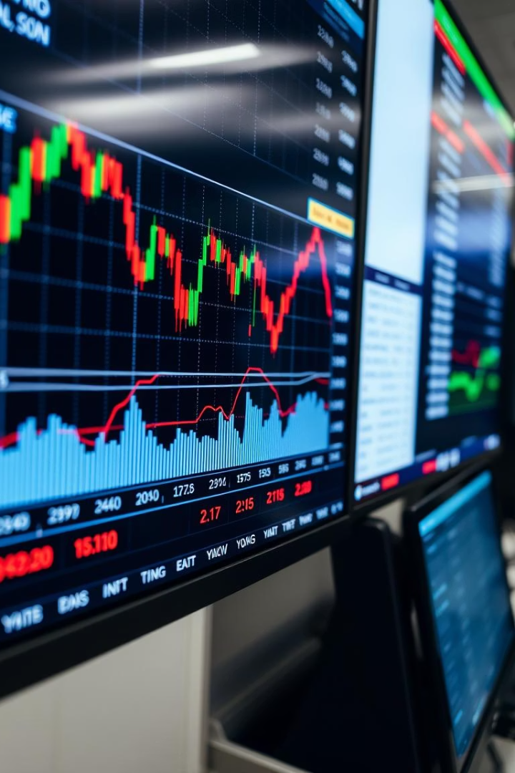
Project Question: Regression-Based Stock Price Prediction
Objective
Data Source
Develop a model forecasting next-day stock prices accurately.
Historical data including open, close, high, low, and volume.
Algorithms
Linear Regression
Random Forest Regressor
XGBoost Regressor

Slide 3
Data Preprocessing and Feature Engineering
Data Cleaning
Feature Selection
Data Splitting
Handle missing values and outliers to ensure data quality.
Identify relevant indicators like moving averages to improve prediction.
Use 80% data for training and 20% for testing the model.

Slide 4

Model Implementation and Training
Linear Regression
Random Forest Regressor
Baseline model capturing simple linear patterns.
Ensemble model capturing complex non-linear relationships. Tuned with 100 trees and max depth 10.
XGBoost Regressor
Gradient boosting achieving high accuracy. Tuned with learning rate 0.1 and 100 estimators.

Slide 5
Evaluation Metrics
R-squared (R²)
Mean Squared Error (MSE)
Root Mean Squared Error (RMSE)
F1 Score
Shows variance explained; aim for R² > 0.8 for strong accuracy.
Balances precision and recall, important for classification tasks.
Average of squared errors; lower means better precision.
Square root of MSE; easier to interpret in price units.

Slide 6

Results and Visualization
Model Performance
Linear Regression: R² = 0.65
Random Forest: R² = 0.85
XGBoost: R² = 0.90
Trend Insights
Visual comparison reveals predictive accuracy over time.
Error Analysis
Residuals distribution identifies model strengths and weaknesses.

Slide 7



Benefits and Insights
Trend Identification
2
Visual tools highlight price movement patterns effectively.
Improved Accuracy
1
XGBoost outperforms with the highest prediction accuracy.
Data-Driven Decisions
Models inform smarter, evidence-based investment choices.
3

Slide 8




Conclusion and Future Work
Current Focus
Future Enhancements
Continuous Improvement
Regression models predict next-day stock prices effectively.
Add sentiment analysis and news data for richer inputs.
Retrain models regularly for kept accuracy over time.

